Slide 1

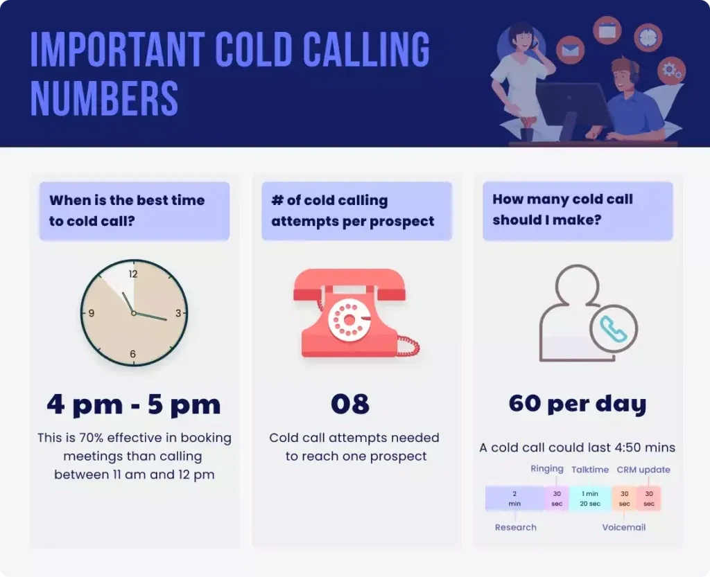
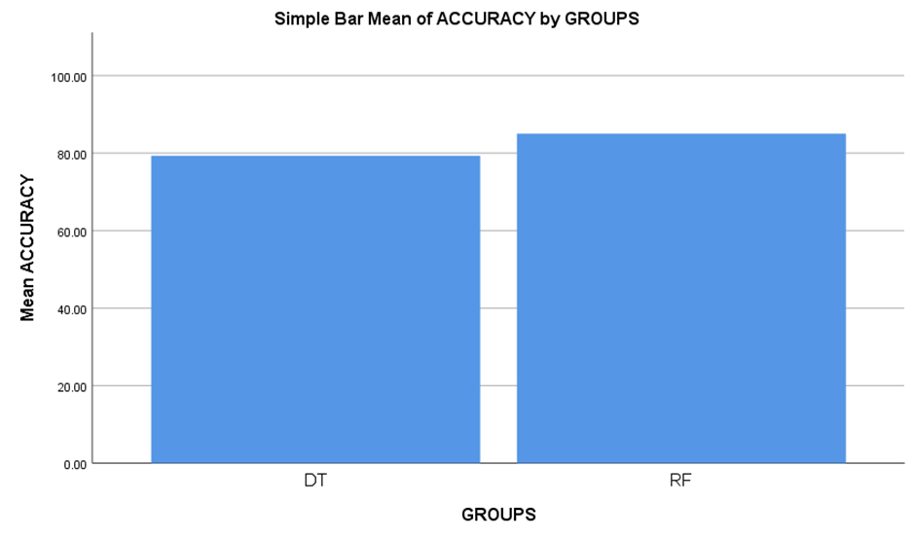
Name: B. Hemanth Chowdary Register Number: 192211206
Guided by Dr. Nelson Kennedy Babu C
Ms. Poorani.S
Guided by Dr. Mary Valantina. G
Insurance Cold Calling Optimization Using Random Forest Regression Compared With
Decision Tree Regression For Improved Accuracy
INTRODUCTION
The primary aim of this research is to optimize the cold-calling process for insurance companies, focusing on improving efficiency, reducing resource consumption, and enhancing overall productivity. By refining cold-calling strategies, insurance companies can more effectively attract new customers and maximize profits
To identify factors like call timing, audience demographics, and communication skills that affect cold-calling success and to evaluate the effectiveness of various machine learning techniques, such as Random Forest Regression and Decision tree regression, in streamlining marketing and sales initiatives for insurance companies
Use machine learning algorithms, such as Random Forest Regression and Decision tree regression, to analyze and optimize cold-calling strategies
Enhanced sales outcomes for insurance companies, with higher conversion rates and increased customer satisfaction, resulting from more targeted and data-driven cold-calling methods
Fig 1. Important metrics for Cold Calling
MATERIALS AND METHODS
The Data was collected from Kaggle.
The data has been preprocessed and performed various techniques like Data cleaning
The data has been split into two different datasets (i.e. Training set – 75% and Testing set – 25%)
Then, performed model evaluation and model validation using Random Forest regression and Decision Tree regression
Data Collection
Dataset Splitting
Data Preprocessing
RF,
DT
Testing and Training dataset
Feature Engineering
Output
Process of evaluating and optimizing Insurance Cold Calls
RESULTS
Table 1. The Mean Accuracy of the Random Forest Regression algorithm and the Decision Tree Regression
 | Group | N | mean | Std. Deviation | Std Error mean
Accuracy | Random Forest Regression | 10 | 85.4000 | 3.74166 | 1.18322
 | Decision Tree Regression | 10 | 77.2000 | 2.98329 | 0.94340
The figure shows the mean accuracy of the Random forest regression which is greater than the Decision Trees algorithm. X axis is Random forest regression vs Decision Trees, Y axis is Mean Accuracy. Error bar is +/-2 SD
Fig 2. The Mean Accuracy Graph
DISCUSSION AND CONCLUSION
Random Forest Regression outperformed Decision Tree Regression in predicting insurance cold-call outcomes, achieving an average accuracy of 85.4% compared to 77.2%.
Statistical analysis revealed higher standard deviation and mean standard error for Random Forest Regression compared to Decision Tree Regression, indicating greater variability in predictions.
Independent variable analysis showed a significant difference in accuracy rates between Random Forest Regression and Decision Tree Regression, with a mean difference of 8.2%.
The study suggests potential for insurance firms to enhance customer acquisition and profitability through optimized cold-calling techniques and data-driven insights.
Random Forest Regression's alignment with the procedural nature of cold calling enhances its effectiveness, while Decision Tree Regression's interpretability may be advantageous in certain scenarios.
BIBLIOGRAPHY
Gearheart, James. 2020. End-to-End Data Science with SAS: A Hands-On Programming Guide. SAS Institute. DOI: 10.1111/insr.12423.
Larose, Daniel T. 2005. Discovering Knowledge in Data: An Introduction to Data Mining. John Wiley & Sons. DOI: 10.1002/9781118874059.
León, Raúl, María Jesús Muñoz-Torres, and Jose M. Moneva. 2016. Modeling and Simulation in Engineering, Economics and Management: International Conference, MS 2016, Teruel, Spain, July 4-5, 2016, Proceedings. Springer. DOI: 10.1007/978-3-319-40506-3.
Nicosia, Giuseppe, Panos Pardalos, Renato Umeton, Giovanni Giuffrida, and Vincenzo Sciacca. 2020. Machine Learning, Optimization, and Data Science: 5th International Conference, LOD 2019, Siena, Italy, September 10–13, 2019, Proceedings. Springer Nature. DOI: 10.1007/978-3-030-37599-7.
Denuit, Michel, Donatien Hainaut, and Julien Trufin. 2019. Effective Statistical Learning Methods for Actuaries I: GLMs and Extensions. Springer Nature. DOI: 10.1007/978-3-030-25827-6.

